Slide 1

Data Science SQL Mini-Project L1
PROJECT OVERVIEW :- This project involves analyzing a dataset containing information about used cars through SQL queries, the project aims to provide insights and trends within the data that can provide valuable business insights to stakeholders in the automotive industry. The project involves several key steps:
Data exploration
Query optimization
Insight generation
Business recommendations
Presentation BY:- K.MAHESH RATNA KUMAR
BY:- K.MAHESH RATNA KUMAR

Slide 2
INTRODUCTION
Introduction to the dataset:
The dataset contains information on used cars.
This dataset serves as a valuable resource for analyzing trends and patterns within the used car market.
Objectives of the project:
Use SQL queries to explore and analyse the dataset.
Extract meaningful insights
Provide actionable recommendations based on the insights which will help in decision making process.
Significance of the analysis:
The analysis of this holds a significant importance to various stakeholders in the automotive industry like car dealerships,manufacturers,consumers and the business itself.
By understanding trends and patterns stakeholders can make informed decisions related to pricing, inventory management, and marketing strategies.

Slide 3
Dataset Overview
Overview of the dataset:
The dataset contains information about used cars, including various attributes that describe each car's characteristics.
It serves as a valuable resource for understanding trends and patterns within the used car market.
Key Columns:
Name: The name or model of the car. Selling price: The price at which the car was sold. Km driven: The number of kms driven by the car. Fuel: The type of the fuel the car uses. Seller Type: Individual,dealer,trustmark dealers. Transmission: Manual or Automatic Owner: The number of previous owners of the car. Engine: The engine displacement in cubic centimeters (CC). Max Power: The maximum power output of the car's engine.

Slide 4
Methodology
In this project the below queries and techniques were used to retrieve and analyze data from the dataset.
Data Retrieval Queries: These are used to retrieve specific data from the dataset. For example Select statements were used to get the columns which are needed and where statements were used to filter the data based on specific conditions like price range, km range, fuel type, seller type and so on..
Aggregation Functions: Aggregation functions like MAX, AVG, COUNT were used to calculate summary statistics or aggregate values across multiple rows. These functions help us understand overall trends in the data, such as the average selling price of cars or the total number of cars sold by a particular seller type.
Group by Statements: These statements were used to group rows that have the same values into single rows, this helps in reducing the number of rows and also avoids repeating the rows that have same values by grouping all of them into a single row.

Slide 5
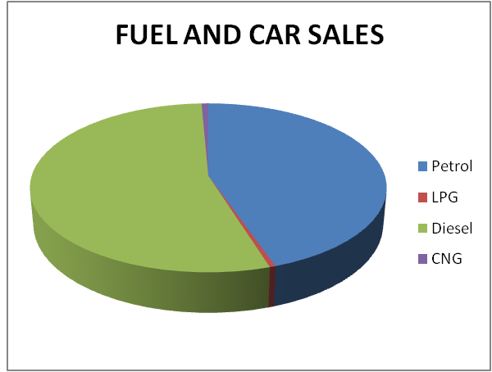
Insights
Number of cars based on fuel type. This shows the number of cars sold and their fuel type.
Using this we can understand the market trend and based on it we can build the inventory.

Slide 6
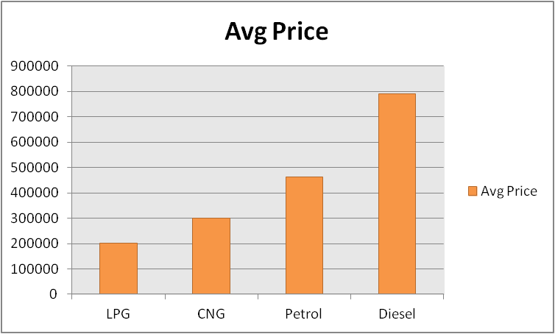
2.Avg Price for different fuel types:-
This helps understanding pricing across different fuel types, which can help in pricing strategies.
We can understand which fuel type is preferred by the customers and build our inventory around it.

Slide 7
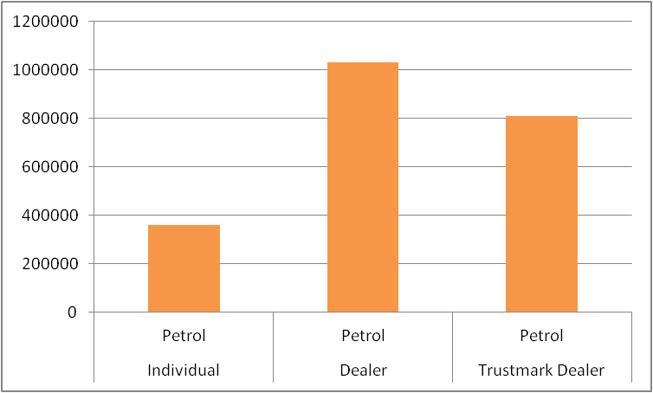
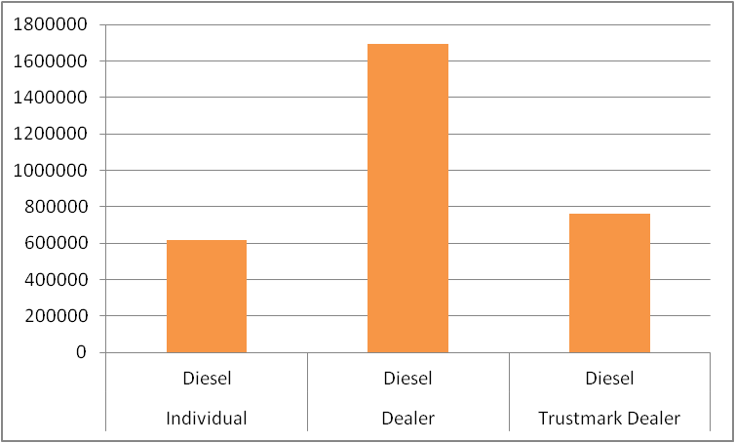
3.Avg Price between different seller types:-
This provides an insight which helps in pricing, inventory management.
which in turn helps in profitability of the business.

Slide 8
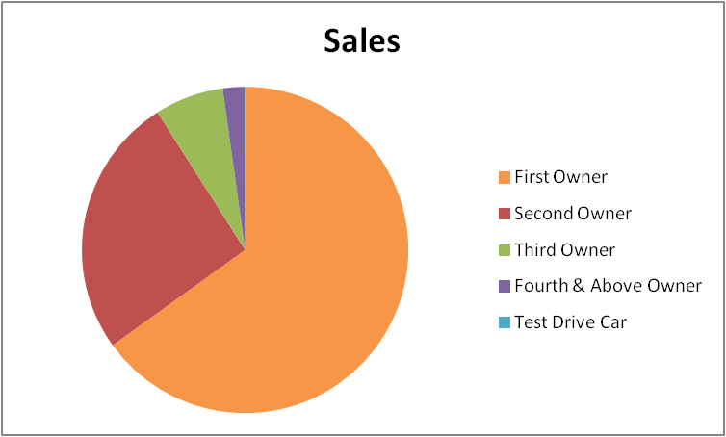
4.Car sales across different owners:-
This provides insights into customer preferences with pre-owned vehicles.
This guides inventory management and marketing strategies to maximize sales.

Slide 9
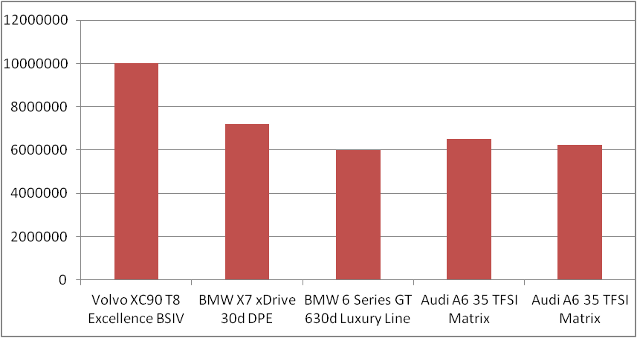
5.Top 5 cars with highest prices:-
This provides the top 5 highest prices of the cars.
This data helps in catering to high value customers.

Slide 10
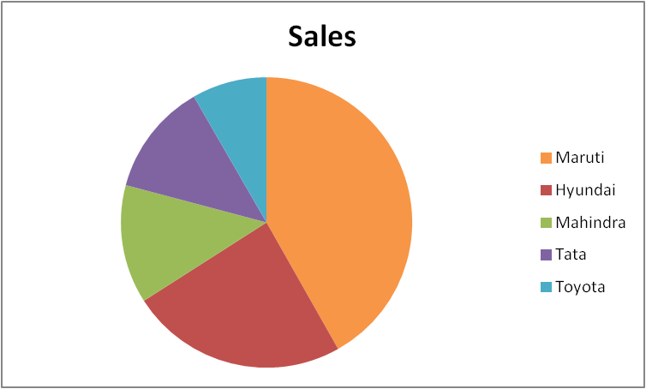
6. Top 5 brands with their sales:-
Helps business focus on the best-selling brands to maximize sales and meet demand effectively.
Also helps in inventory, sales, pricing, and marketing.

Slide 11
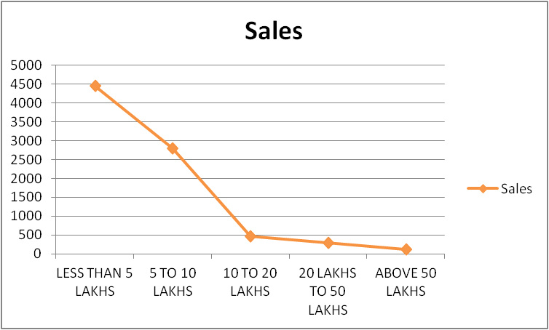
7.Price range and the sales:-
This helps in understanding customer choices and market demand for cars at different price points.
This guides pricing strategies and inventory management to meet customer needs and maximize sales revenue.

Slide 12
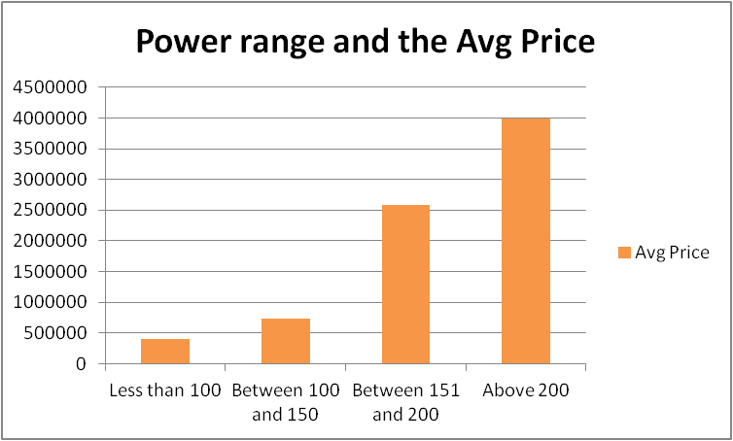
8.Avg car prices with different power ranges:-
This helps in understanding the relationship between the power range and the price of the car.
We can see that as the power increases the price of the car also increases. They are directly proportional to each other.

Slide 13
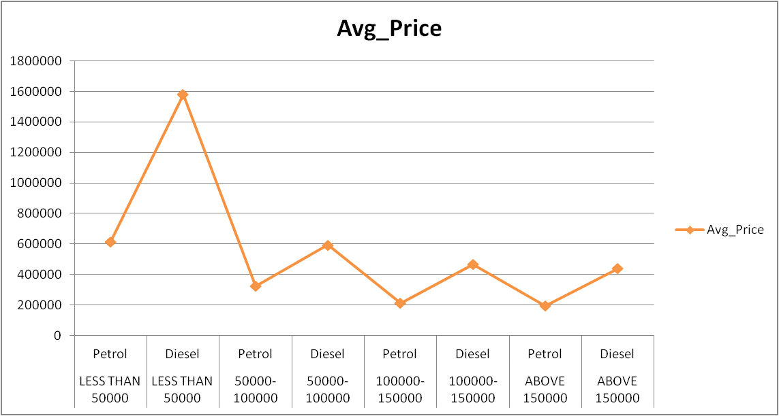
9.Km range and the fuel type with their avg sale price:-
This offers insights into pricing trends relative to mileage.
The chart clearly shows that the price of the diesel cars is higher than the petrol cars with the same km range.

Slide 14
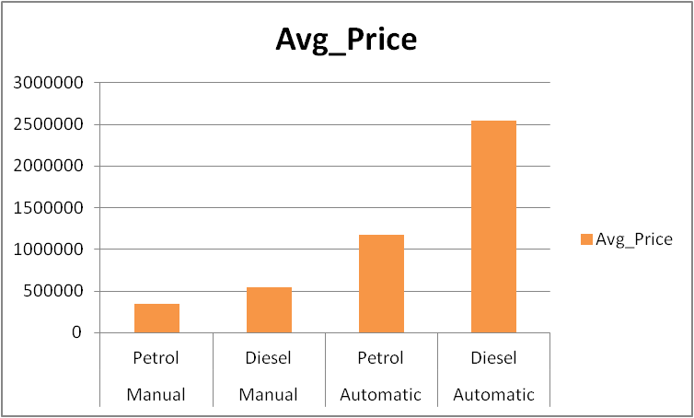
10.Avg price between manual and automatic along with fuel:-
This shows the avg price of the cars between manual and automatic along with the fuel type.
The diesel cars have the higher price compared to the petrol cars in both the categories.

Slide 15
Conclusion
Diesel cars have more demand and have high selling price as compared to other fuel types.
Dealer has the high price for the same car sold as compared to the other seller types, followed by trust mark dealer and then individual.
As the price of the car increases the number of cars sold decreases which validates that India is a price sensitive market.
As the owners of the cars increases the number of cars sold decreases.
Challenges faced:- Lack of data - There was no data about in which year the car was sold and the place in which it was sold.

Slide 16
Future Work
Adding more data:- We can add more data like the year in which the car was sold and the place in which it was sold.
This will help in analysing the data in a better way and provide more useful insights.
Monitor progress, take Feedback and improve:- See how the analysis works over time and take feedback from all the parties involved and improve the business from time to time. We need to change and adapt quickly in order to stay in the business. “Change is the only constant”.

Slide 17


